Slide 1
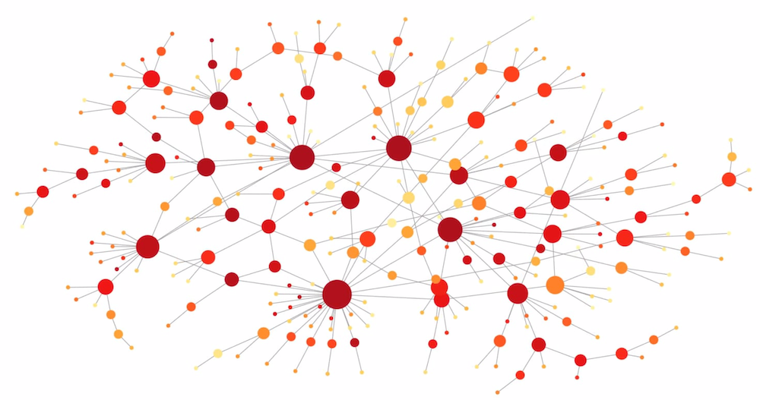
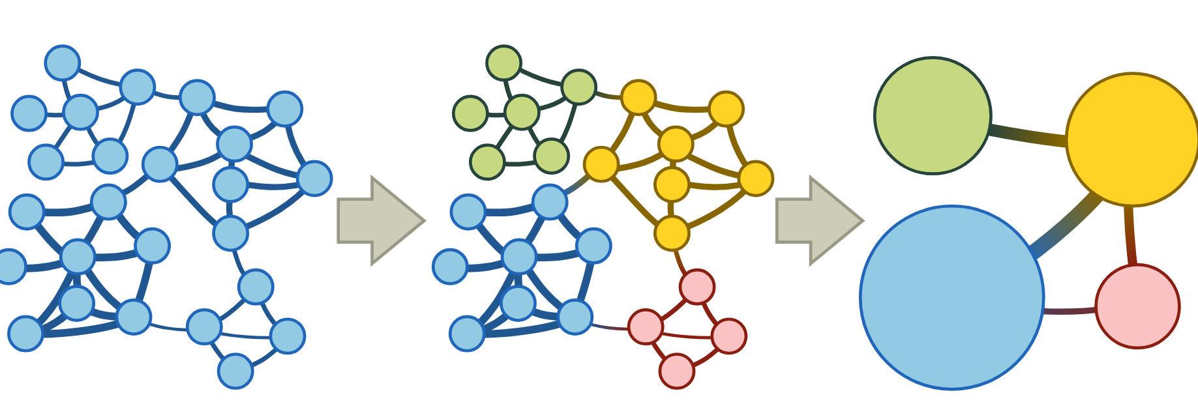
Temporal networks analysis: future directions

Slide 2
Link stream analysis
Edges
L =
0 0 … 1 0 0 0
How to aggregate? What are the relevant structures?
0 0 … 0 0 0 0
0 0 … 0 1 0 0
1 0 … 0 0 0 0
0 0 … 0 0 0 0
Time
0 0 … 1 0 0 0
0 0 … 0 0 0 1
0 0 … 1 1 0 0
0 1 … 0 0 0 0
0 0 … 0 0 0 1

Slide 3
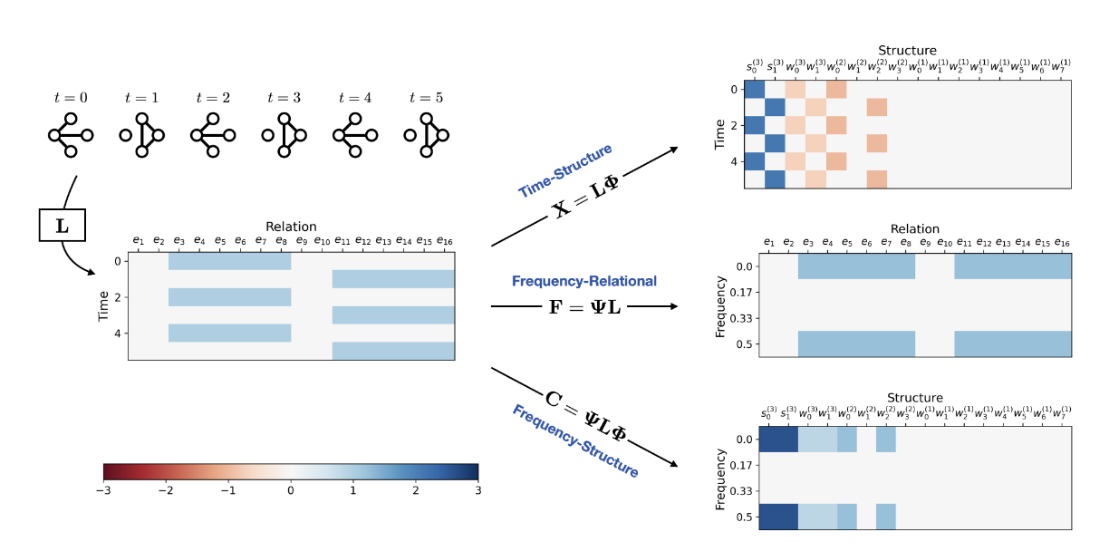
Link stream analysis
Edges
„Wavelet“ transform in „space“ to get relevant structures
Fourier transform in time to identify relevant timescales
L =
0 0 … 1 0 0 0
0 0 … 0 0 0 0
0 0 … 0 1 0 0
1 0 … 0 0 0 0
0 0 … 0 0 0 0
Time
0 0 … 1 0 0 0
0 0 … 0 0 0 1
0 0 … 1 1 0 0
0 1 … 0 0 0 0
0 0 … 0 0 0 1

Slide 4
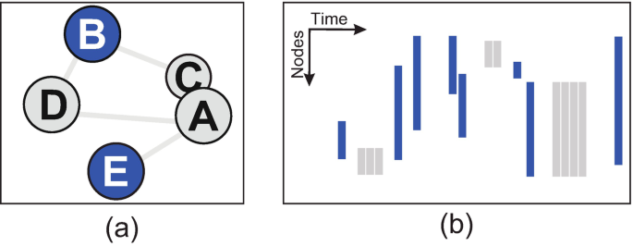
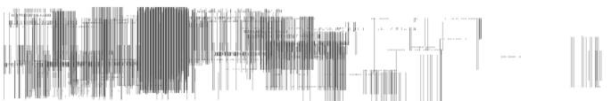
Visualization
Temporal layout:
Nodes
Time
People meeting in a museum dataset, Claudio Linhares et al. 2023

Slide 5
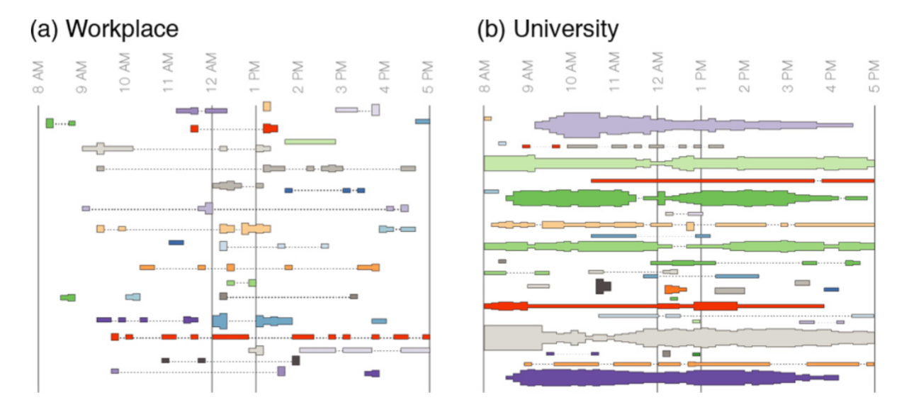
Visualization
Communities detection:
The coupling between time slices (or layers) captures intermitent communities as single entities. This coupling means that the graph becomes a 3D structure (not just a series of 2D slices) and this is what is used for community detection

Slide 6
Modelling
Activity-drive framework:
At each time step, each node form m connections with ist neighbors depending on its activity a, which defines a rate of activation (sort of poisson – like)
The m connections are made according to specific assumption, such as popularity, locality etc…
For however artificial this modeling strategy is, we can use it to analyse the nodes of a graph by fitting such a model to the data.

Slide 7
Modelling
Markov-chains:
Each possible edge is a state from the markov chain (I think? The paper is a poorly written…) and fitting is done via a bayesian approach.

Slide 8
Modelling
Random-walk / renewal process:
Model temporal graph either with n random walker evolving on a static structure and having a chance proportional to each static edge to jump (thus, an edge at time t is made)
Or
Model temporal graph by a renewal process on each of the possible edges, generating each edges as a function of time.
Allows to study diffusion among the network.

Slide 9
Time series analysis
Inter-event distribution
Burst size distribution
Autocorrelations
Memory coefficient
…
Bursty time series analysis for temporal networks, hang-hyun Jo & takayukia Hiraoka 2023

Slide 10
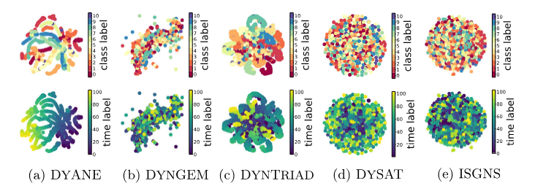
Graph embedding
Embed each node in a low dimensional space to encode key properties about their position in the graph. Is used for tasks such as community detection (see below), link prediction, and node classification.
In temporal networks, one can follow the trajectory of each node in the embedding space.
On static graphs:
- Andrew Y Ng, Michael I Jordan, and Yair Weiss. 2002. On spectral clustering: Analysis and an algorithm
- Pascal Pons and Matthieu Latapy. 2006. Computing communities in large net-works using random walks.
On temporal graphs:
- DySAT trained with attention mechanism on slices to predict future connection. This allows to study which nodes are particularly influencial in the network.
- skip-gram

